Slide 1

Interactive Animations and Games
Lesson 11
Mini-Project: Captioned Scenes
Notes:
Lesson Plan: https://studio.code.org/s/csd3-2023/lessons/11

Slide 2
Teacher Resources
For Teachers!
Lesson Overview
After a quick review of the code they have learned so far, students start working on their next creative project of the unit. Using the problem-solving process as a model again, students define the scene that they want to create, prepare by thinking of the different code they will need, try their plan in Game Lab, then reflect on what they have created. They also have a chance to share their creations with their peers. The open-ended nature of this lesson also provides flexibility for the teacher to decide how long students should spend on their work, depending on the scheduling demands of the particular course implementation.
More guidance and resources for this lesson are available in the Lesson Plan:
https://studio.code.org/s/csd3-2023/lessons/11

Slide 3


Slide 4

Interactive Animations and Games Lesson 11 - Warm Up
Journal Prompt:
Write down as many blocks as you can remember from Game Lab.
Make sure you know what each one does, especially the inputs, or parameters, for each of the blocks.

Slide 5
Interactive Animations and Games Lesson 11 - Warm Up
Question of the Day
How can we use Game Lab to express our creativity?

Slide 6


Slide 7

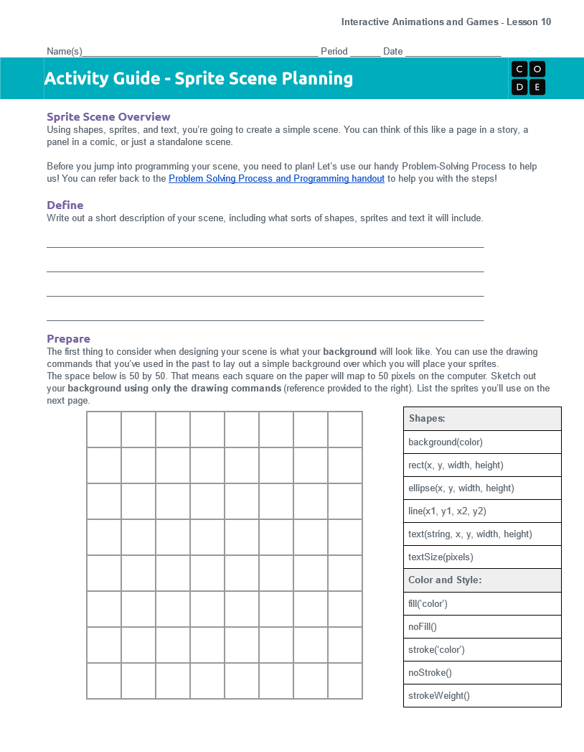

Interactive Animations and Games Lesson 11 - Activity
Distribute
You should have:
Sprite Scene Planning Activity Guide
Pen/Pencil

Slide 8
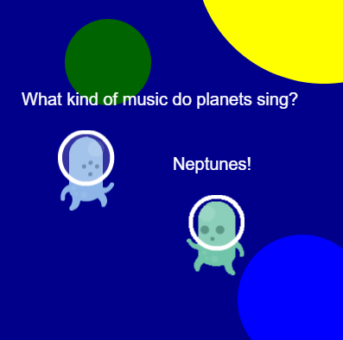
Interactive Animations and Games Lesson 11 - Activity
Captioned Scene Planning
Use multiple sprites, shapes, and text to create a scene!
Your captioned scene can be as creative as you want!

Slide 9
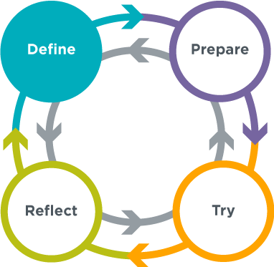
Interactive Animations and Games Lesson 11 - Activity
Captioned Scene
Your captioned scene will show that you can…
Apply sprites, texts and shapes concepts to create a program
Use a structured process to plan and develop a program
Define
Describe the captioned scene you want to create.
You are NOT limited to just sprites, text, and shapes …
You can implement variables and randomness too!

Slide 10
Interactive Animations and Games Lesson 11 - Activity
Captioned Scene
Prepare
Make a sketch of your captioned scene
A table of blocks is provided to help you plan
List the sprites you’ll use to create your scene

Slide 11
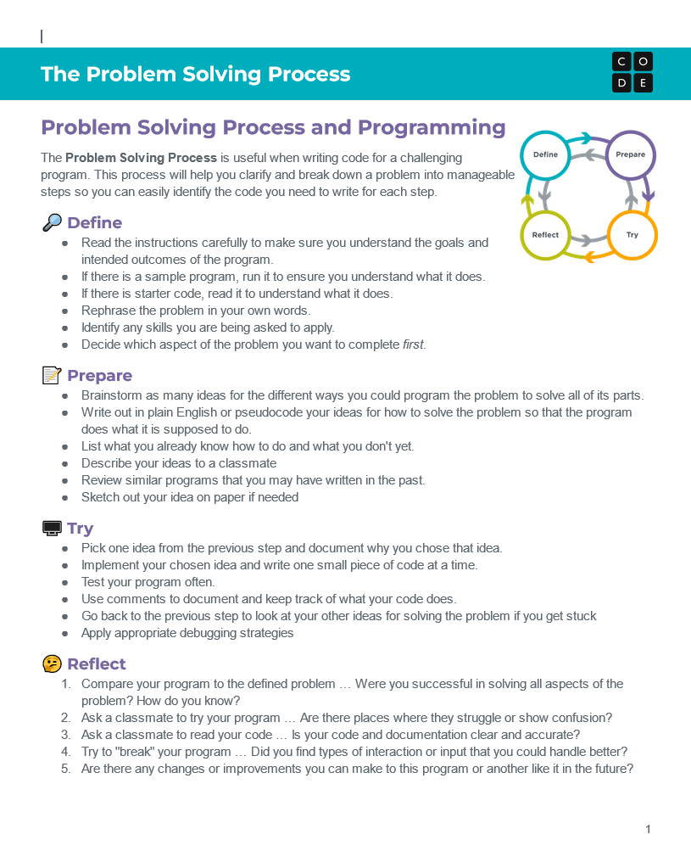
Interactive Animations and Games Lesson 11 - Activity
Distribute
You should have:
Problem Solving Process and Programming Resource
Pen/Pencil

Slide 12
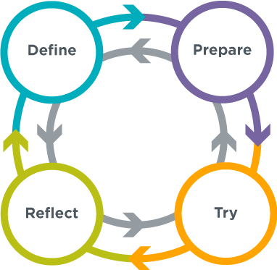
Interactive Animations and Games Lesson 11 - Activity
The Problem Solving Process

Slide 13
Interactive Animations and Games Lesson 11 - Activity
Captioned Scene
Try
Log into Code Studio
Once you are ready, start coding your scene in Lesson 11: Levels 2-5
Use your plan to code your scene, following the level instructions in Code Studio
Create the background
Add sprites
Add text

Slide 14
Interactive Animations and Games Lesson 11 - Activity
Captioned Scene
Reflect
Check over your program one last time to make sure you have included everything that you want.
Were you successful in solving all aspects of the problem?
What part of your animation are you most proud of?
What was the most challenging?
Are there any changes or improvements you can make to this program or another like it in the future?

Slide 15
Interactive Animations and Games Lesson 11 - Activity
Captioned Scene
Gallery Walk
Look at the scenes your classmates have created.
What is interesting about each scene?
How did they use their coding skills creatively?
Is there anything you see that you’d like to try?

Slide 16


Slide 17

Interactive Animations and Games Lesson 11 - Wrap Up
Journal Prompt:
What was one especially creative way you saw someone else use the blocks today?

Slide 18
Interactive Animations and Games Lesson 11 - Wrap Up
Question of the Day
How can we use Game Lab to express our creativity?

